Slide 1
Sixth Sense Bank
Jiayan Han
Kasandra Woo
Ryan Chen
Sean Jung

Slide 2
Agenda
Meet the Team
Data Mining Process Overview
Who are we?
Our Task
Data Understanding and Preparation
Our Model
Model Deployment
Q&A

Slide 3
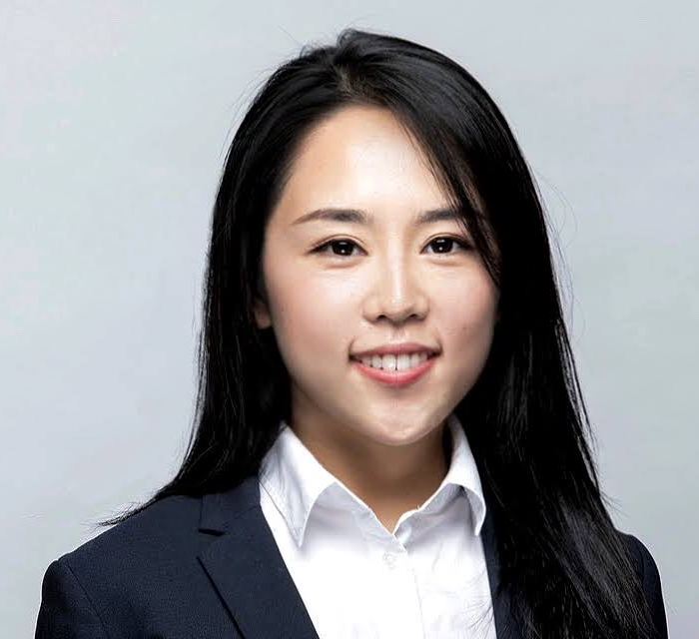
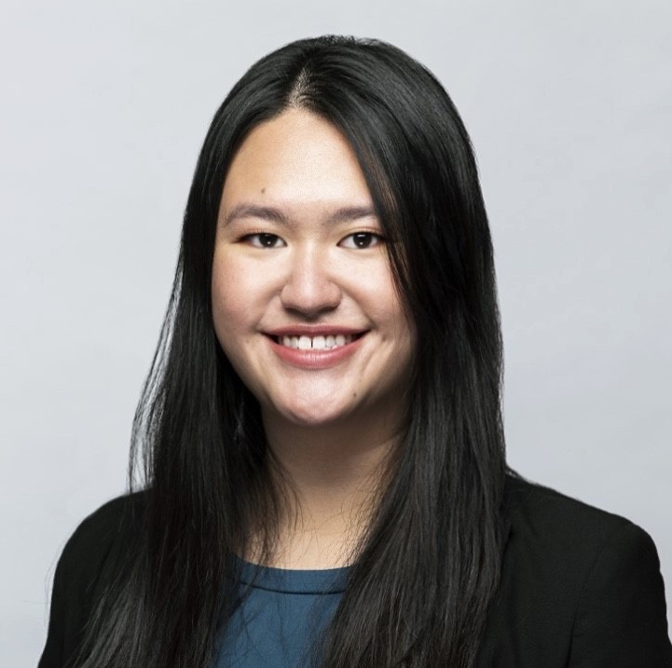
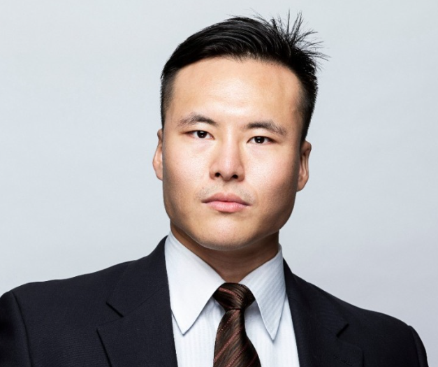
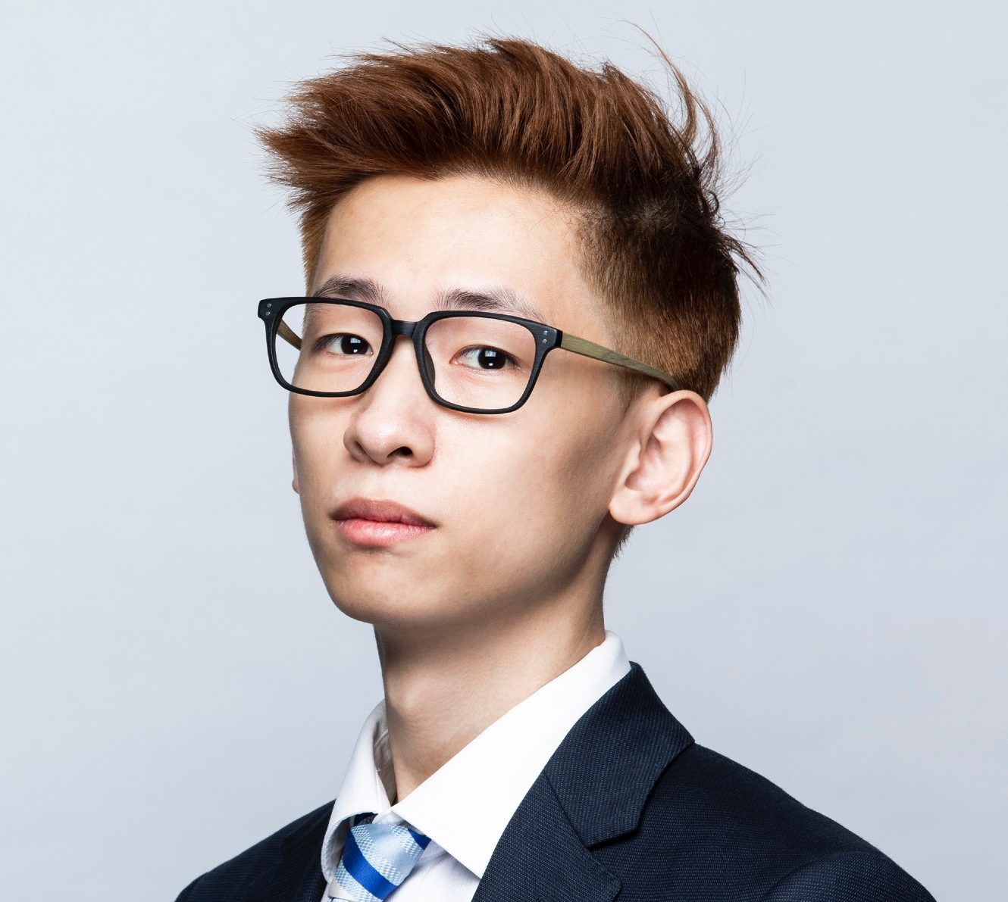
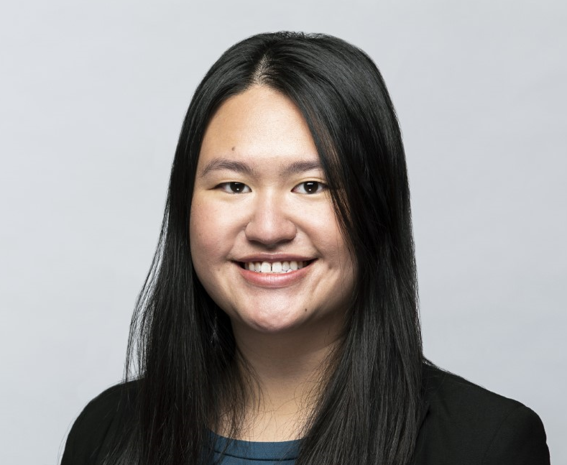
The Team
Answer the question, “Why are we the ones to solve the problem we identified?”
Sean Jung
Ryan Chen
Jiayan Han
Kasandra Woo
President
COO
Head of Data Analytics
Data Analyst

Slide 4
Who are we?
Internationally recognized and trusted bank that is located in France, Spain and Germany
Provide world class banking and financial products and services to our customers

Slide 5
Our Task
Continue to strengthen our internationally recognized brand
Centered around increasing customer satisfaction and loyalty
Decrease churn rate
Create predictive models to predict churn and identify where we should focus our efforts
Notes:
Establish (Inter)nationally-recognized brand (CEO) >
Increase Customer satisfaction/loyalty (VP) >
Decrease churn rate, which is a KPI for customer satisfaction/loyalty (Director) >
Actual data analysis/work with predictive models (Data Analyst)

Slide 6







Data Mining Process Overview
What are the informative variables to answer our question?
What improvement can be done to current features?
What actions can our bank take to impact churn?
What attributes impact churn the most?
Identify target variables
Identify predictor variables
Perform feature engineering
Business Understanding
Data
Understanding
Data Preparation
How should we implement the model?
What are some potential risks with the implementation?
Data
kNN
Logistic Regression
Decision Tree
Modeling
Deployment
Evaluation
Confusion Matrix
Accuracy, Precision, Recall, F-1
AUC
Notes:
I want to go over the process for this data mining task
based on what Kasandra talked previously, we want to focus on decreasing churn rate in our bank, so we created subproblems that can be solved with models
Then we went ahead and study the available data, to see if we will be able to answer our questions with these data.
Prepare for modeling, perform feature engineering to ensure that we can catch complex interaction
Classification problem

Slide 7
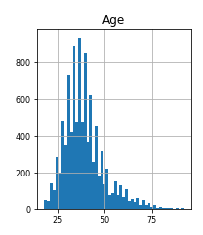
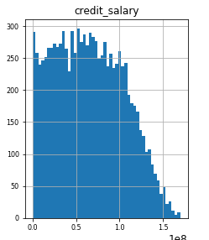
Data Understanding and Preparation
Target variable – Customer Churn Rate (0, 1)
Transforming skewed variables
Log(Age)
Log(Credit Salary)
Creating interaction terms
Salary_balance = EstimatedSalary * Balance
Tenure_product = Tenure * NumOfProducts
Credit_salary = CreditScore * EstimatedSalary
Credit_balance = HasCrCard* Balance
Encoding categorical variable
Geography column
Standardizing data for kNN

Slide 8
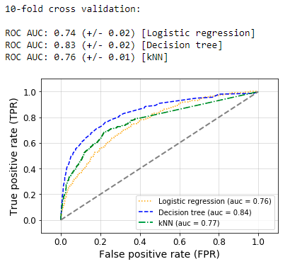
Model Comparison
 | Non-nested CV Accuracy | Nested CV F1 Score
kNN | 0.68 | 0.67
Logistic Regression | 0.62 | 0.63
Decision Tree | 0.75 | 0.74
AUC: 0.74 (+/- 0.02) [Logistic regression]
AUC: 0.83 (+/- 0.02) [Decision tree]
AUC: 0.76 (+/- 0.01) [kNN]
Notes:
Based on the accuracy, F1 score, and ROC curve, we decided to proceed with the decision tree as our best model.

Slide 9
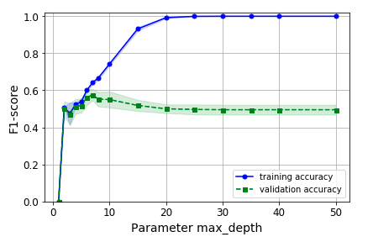
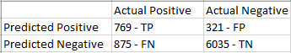
Decision Tree Model
Optimal Model:
criterion='gini', max_depth=8,
min_samples_leaf=2, min_samples_split=25
Accuracy: 0.85
Precision: 0.71
Recall: 0.47
Confusion Matrix:
Fitting Graph:

Slide 10
Model Deployment
Decision Tree
Prediction
Most Informative Attributes
Other Considerations:
Ethical Issues
Risks
Notes:
Using the decision tree, we can predict if the customer will leave or stay
- this is a classification problem
- focus on customers we predict will leave
Attributes that impact churn: Age, Number of Products, and whether or not they are an active member
We can use age as a way to inform us on how to best engage with our customer
Try to upsell customers
Develop membership benefits to help better engage our customers
Ethical Considerations
We would not discriminate customers based on age
Risks: how do we mitigate it
Consider the costs of membership benefits and additional services
- Mitigate by being conservative about the additional costs we will incur and offering them to just the customers that will value them
Missing the mark on who and how we communicate and engage with our customer and negatively impacting our goodwill and brand
- mitigate by being intentional about the cadence, content and tone of our communications
- Having a structured and well thought out go to market plan

Slide 11

Questions?

